Slide 1
Bot!Battle!:
Game Display Team
Josiah Hertzler
Taha Siddique Jack McFann
Tom Hoffman Sawyer Brown

Slide 2
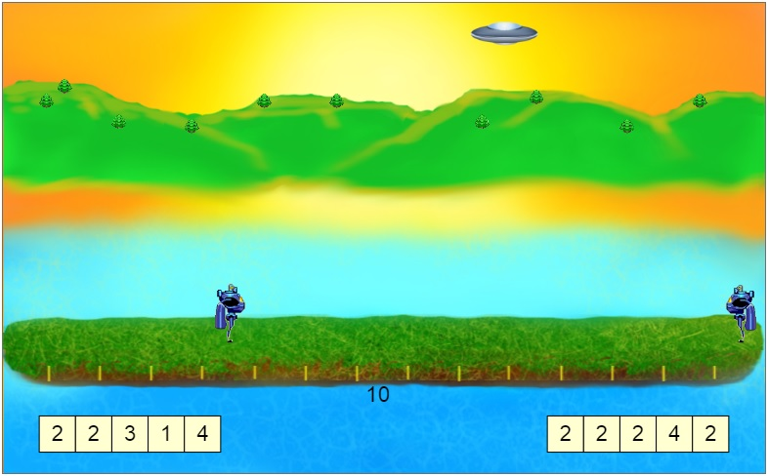
The Big Picture

Slide 3
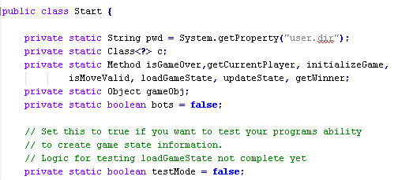

Three Main Tasks
Game Evaluation
Game Display
Web Service

Slide 4
Our Job
Flexible animation commands
Intuitive replay screen
A space for users to test code
Creation of a Game Challenge

Slide 5
Design Phase

Slide 6
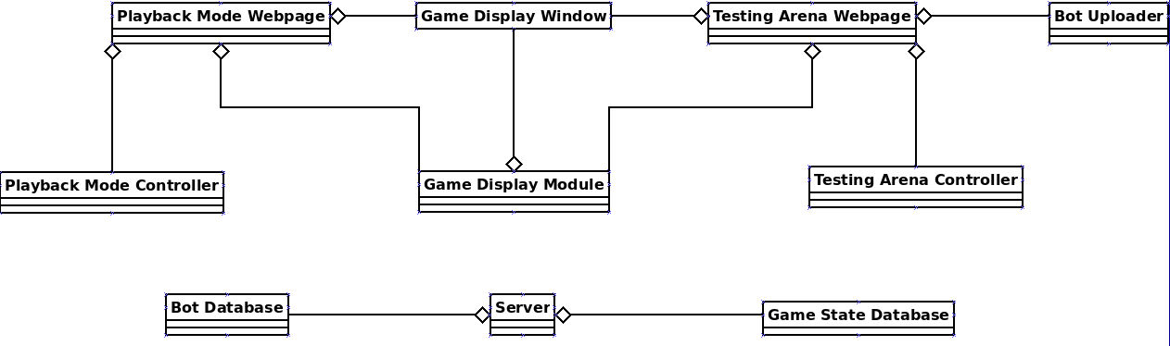

Slide 7
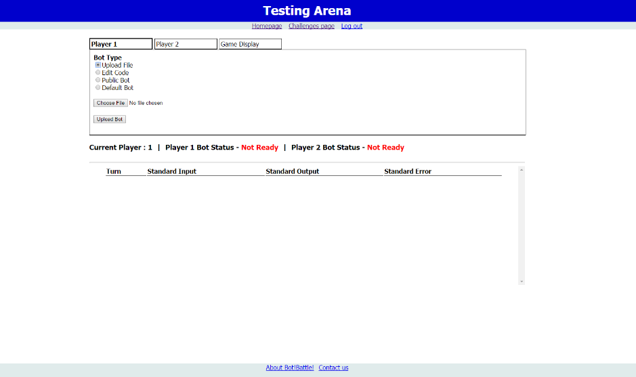
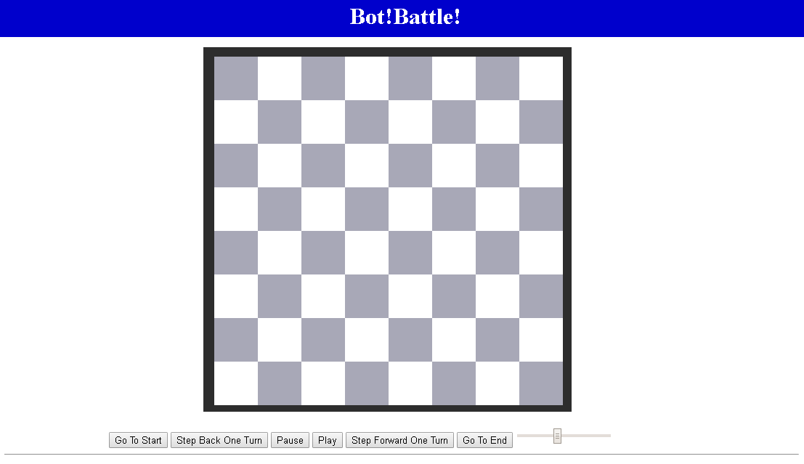
Displaying A Game
Playback Mode
Testing Arena

Slide 8
Playback Mode
View completed matches
Speed Slider
Turn by turn
Easy to use

Slide 9



Slide 14


Slide 15



Slide 16
Testing Arena
Debugging Display
Alter your bot
Upload File
Edit Code
Test other bots
Public Bot
Default Bot

Slide 17
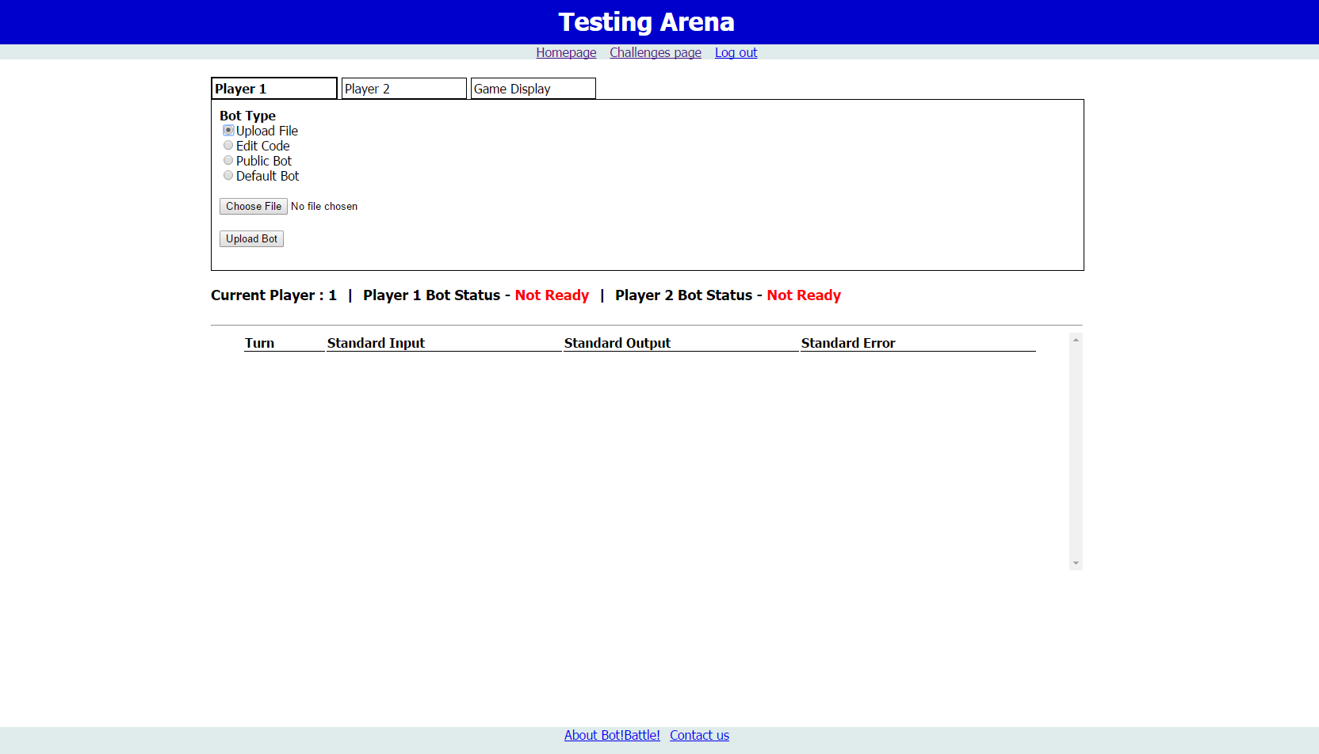

Slide 18
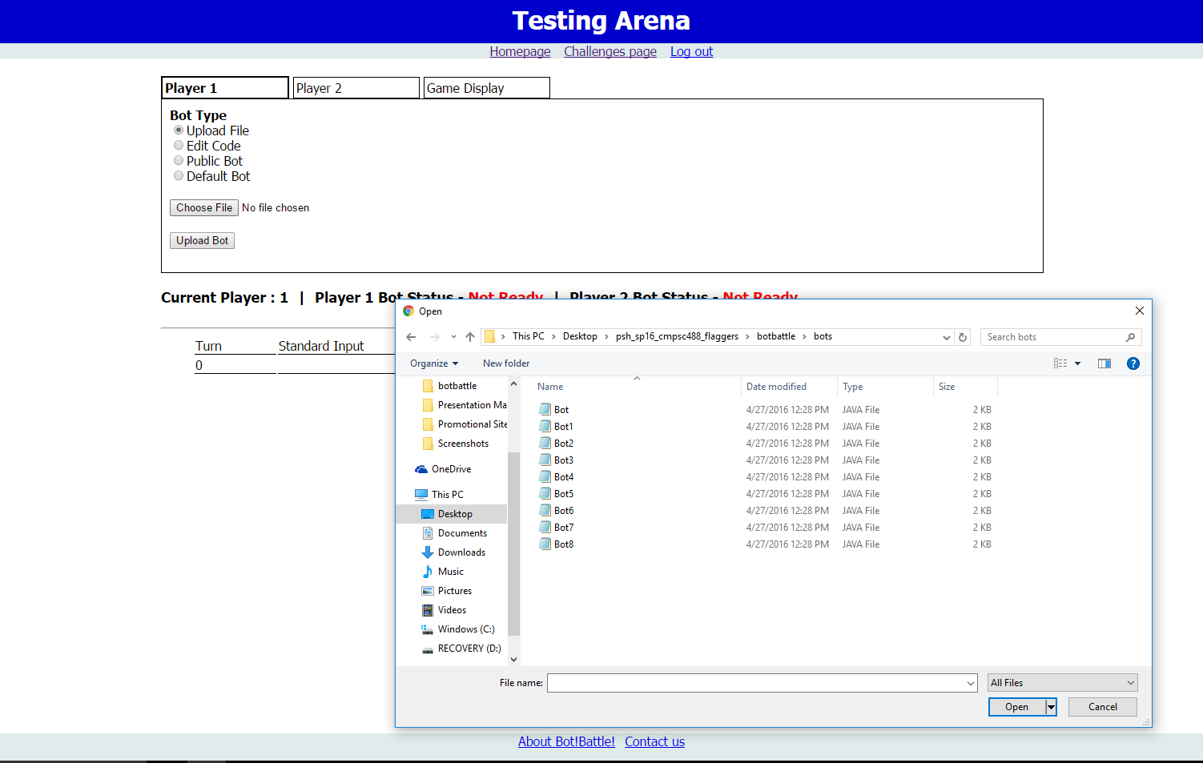
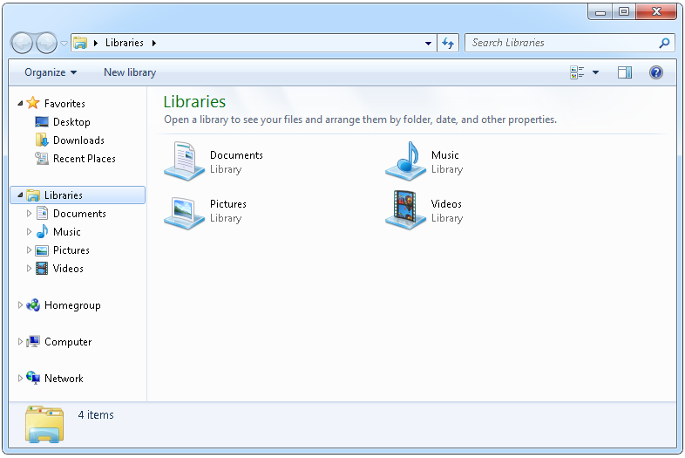

Slide 19
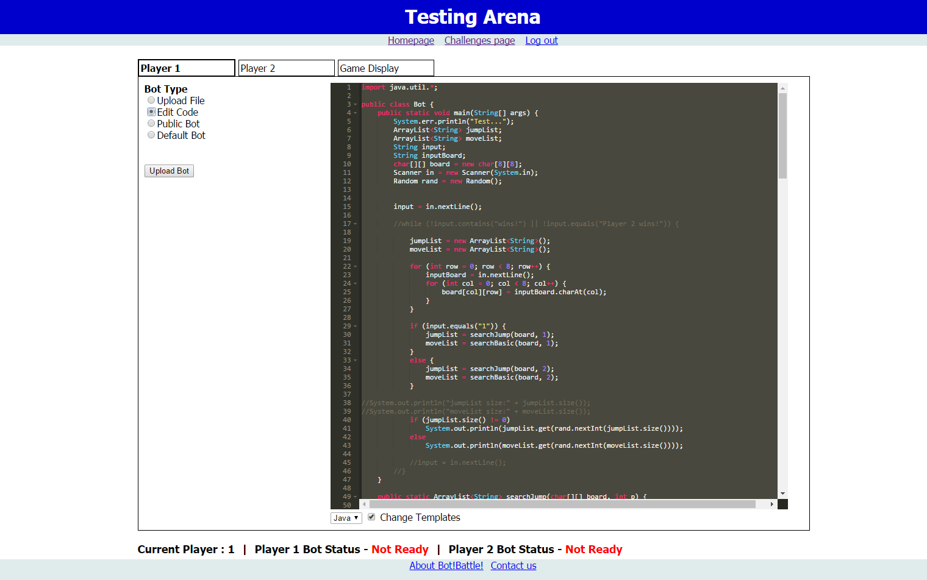

Slide 20


Slide 21
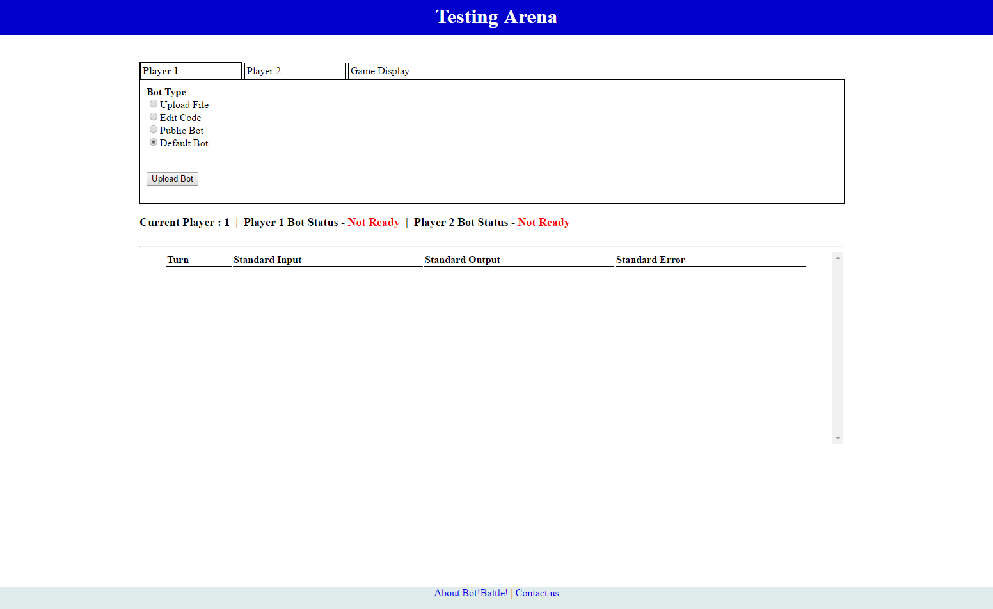

Slide 22
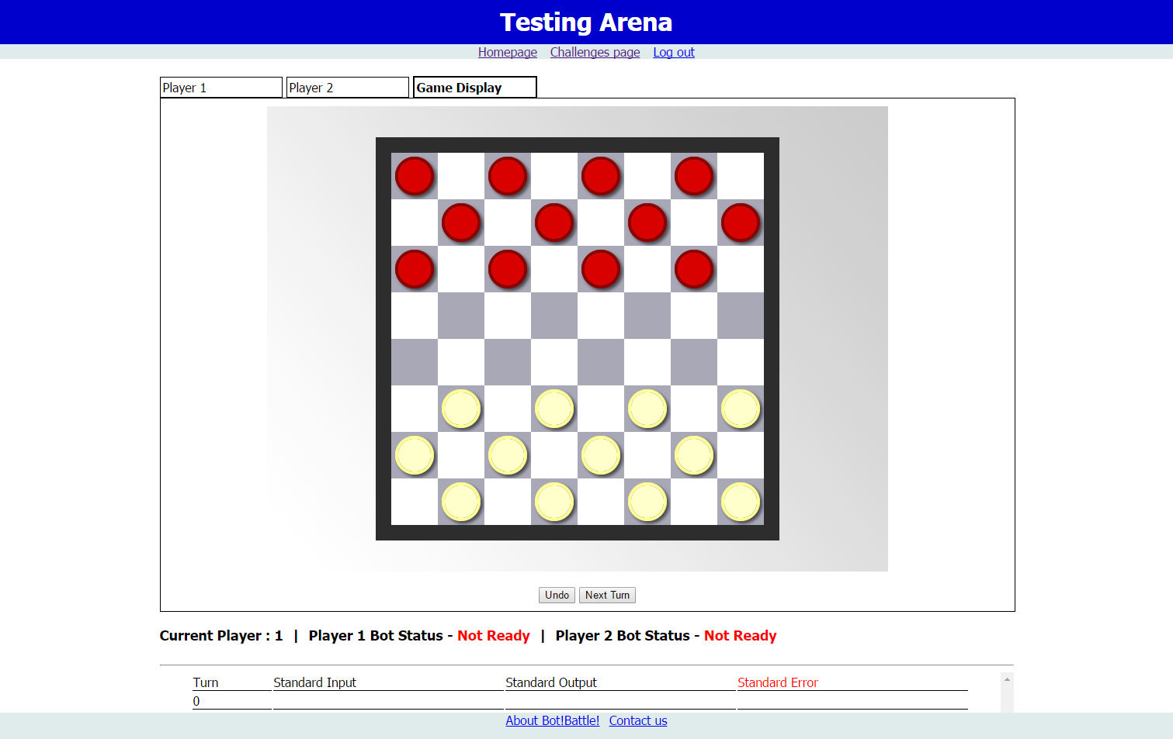

Slide 23
Game Challenges

Slide 24
Capture The Flag
Math Based Game Challenge
Many layers of strategy
Aggressive vs Conservative
Attack Focus vs Defense

Slide 25


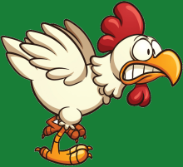


Flags Captured: 0
Flags Captured: 0

Slide 26
Questions?

